Slide 1

In the Lecture Series Introduction to Database Systems
502051

Slide 2
First Lecture
We discuss the rationale and motivate and outline the syllabus of the course
Notes:
The question we address today is “what is in a database course?” In this first lecture we discuss the rationale and motivate the syllabus of the course.

Slide 3

Why are we here?
Database is not taught at MIT
Database is just another application
Database is subsumed by fundamental topics
Notes:
What differentiates the above examples from any other computer application? We can argue that any computer application manages data and therefore qualifies as a database application. Indeed, very serious people argue that database applications are just applications
“Database is just another application”
and that, therefore database should not be taught in computer science programs in universities.
“Database is subsumed by fundamental topics”
They argue that it suffices to study fundamental topics such as data structures and algorithms, networking, operating systems, and human-computer interaction.
Of course, and that is why we are here, I believe there is something special about database applications, that makes them worth studying in a computer science program in a university.

Slide 4
Database Application
Can we devise a definition for a ``Database Application’’?
``A database application is a collection of data and the programs that allow the manipulation of these data’’
But this definition fits any computer application ☹
Notes:
To start we can adopt the following definition for a database application:
“a database application is a collection of data and the programs allow the manipulation of these data”

Slide 5





Database Application (Examples)
Can you find examples of database applciations?
Banking
University
Airline reservations
My address book
The e-shop around the corner
Notes:
Can you think about examples of what you would call a database application?
Here are some:
the management of bank accounts,
the management of students, staff, assets and activities in the university,
an airline reservation systems,
an electronic address book,
and an online catalog for the e-shop around the corner.

Slide 6


Database Management Systems
We do not program database applications from scratch.
We use Database Management Systems (DBMS)
DBMS are generic platforms for the implementation and management of database applications

Slide 7

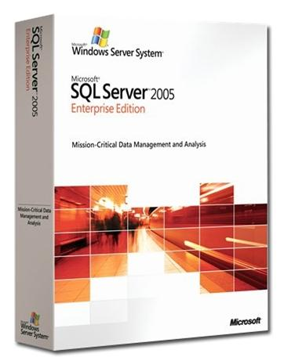



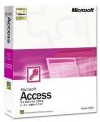
Database management Systems
Example Database management Systems are:
Oracle
SQL Server
Sybase
DB2
PostgreSQL
MySQL
SQLite
MS Access

Slide 8
DBMS (simplified) Architecture
SQL
Data Manipulation Language Statements
Database Control Language Statements
Data Definition Language Statements
Query Optimiser
Query Evaluation Engine
File and Access Methods Manager
Recovery Manager
Concurrency Control
Manager
Buffer Manager
Storage Manager
I/O Manager
STORAGE
Notes:
This slide illustrates the general internal architecture of a database management system. Refer to your textbook “Introduction to Database Systems” for a brief description of the various components. This is beyond the scope of this module. You can choose to follow CS3223 to study in details the architecture of a DBMS.

Slide 9
DBMS Client/Server Architecture
Client
Client
SERVER
Client
Client
Notes:
This slide illustrates the general internal architecture of a database management system. Refer to your textbook “Introduction to Database Systems” for a brief description of the various components. This is beyond the scope of this module. You can choose to follow CS3223 to study in details the architecture of a DBMS.

Slide 10
What is Specific about Database Applications?
Database application
Persistent data
Homogeneous collections
Large amounts of data
Structured data
Integrity
Distributed and
Concurrent
Access
Security
Notes:
Database applications are characterized by a combination of original requirements that not only distinguish them from any other computer application but, most importantly, compel a different approach to the design, programming and management of these applications.
Such a view of database applications is concretized in the platforms supporting their development: the database management systems or DBMS.
Therefore, in this course, we study the concepts and techniques underlying the design, programming, and management of database applications using database management systems.
In order to motivate our study, let us look at the main requirements characterizing a typical database application. There are seven such requirements:
Data must persists
Data comes in large amounts.
Data comes in homogeneous collections
Data is structured.
Integrity of data must be maintained
Data is accessed concurrently from distributed locations.
And security of data must be maintained and access controlled.
Let us illustrate and discuss each of these seven requirements one by one.

Slide 11

Data must Persist
How can data survive the process that created it, and be reused by other processes?
Notes:
Data must persists
Some of you are taking notes for this lecture on their computer. They don’t expect the notes to disappear when they shut down their computer.
“How can data survive the process that created it and be reused by other processes?”.
The notes will not disappear if the document has been saved into a file on disk.

Slide 12
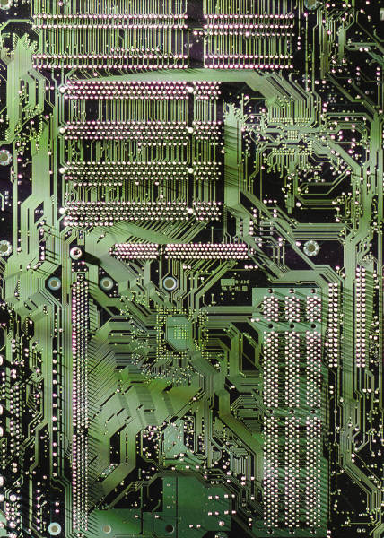


Data must Persist
Primary memory is volatile
Secondary and tertiary memories are persistent
Notes:
Main memory is volatile. The data in main memory does not survive a shut down of the machine. Secondary (internal disks) or tertiary memory (external disks, CDs and tapes) is persistent.
Database management systems take care of persistence for us. We need not write the low level code for creating, opening, closing, writing and reading files.

Slide 13

Data Comes in Large Amounts
There were 190 million registered voters in the 2014 Indonesian elections
Where could one store the names, identification numbers, and electoral districts of voters?
Notes:
Data comes in large amounts.
When one thinks about databases one thinks ‘big’; when you thinks ‘big’ one thinks about database.
There were 147 million voters in the 2004 Indonesian presidential elections.
Where could we store the names, identification numbers, and electoral districts of the voters?
I leave it to you to figure out how many bytes this can be.
Here is a second reason for using external memory. External memory is cheaper and one can afford larger capacities.
Current technology for memory is such that there is a tradeoff between speed and cost (and therefore capacity). The fastest the access to the memory is, the more expensive the memory. The cheapest storage, but also the slowest, is tape. The fastest, and most expensive one, is main memory and it is not even persistent unless you never unplug your computer and it never fails.
We choose tape for our Indonesian voters.

Slide 14
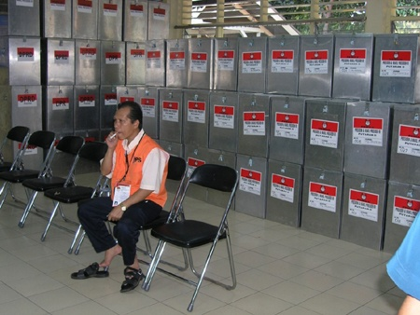
Data Comes in Large Amounts
There were 190 million registered voters in the 2014 Indonesian elections
How could one sort them by alphabetical order of electoral districts and names?
Notes:
Considering that data is stored on external storage, we need to realize that the dominant cost for manipulating data is now access (input/output operations or I/Os).
There were 147 million voters in the 2004 Indonesian presidential elections.
How could we sort them in alphabetical order of electoral districts and names in order to print voters’ lists?
We cannot use the algorithms that you have learned in the “data structure and algorithms” module.
The very first step of any of these sorting algorithms consists in loading the data into a main memory data structure. This is not possible.
Indeed data does not fit in main memory.

Slide 15
Data Comes in Large Amounts
When data is to be stored on secondary or tertiary storage, then we need to devise efficient algorithms taking into account the dominant cost of Input/Output operations (I/Os)
Such algorithms are called external algorithms (e.g., external sort)
Notes:
We need to devise an algorithm that manipulates the data on the disk. Such an algorithm is called an external algorithm (in this case external sort).
It may be different from a normal sorting algorithm as it must focus on minimizing the number of I/Os
If you have time you can try and devise such an external sort algorithm.
You may read about existing external sort algorithms in Ramakrishnan’s book.

Slide 16
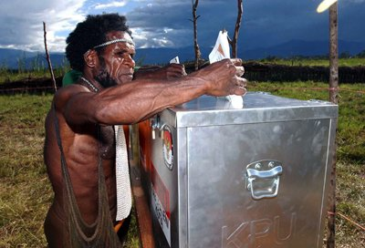
Data Comes in Large Amounts
There were 190 million registered voters in the 2014 Indonesian elections
Imagine the original tapes contain duplicate entries
Think about an algorithm to remove the duplicate entries
Notes:
There were 147 million voters in the 2004 Indonesian presidential elections.
Imagine that the original tapes contain duplicate entries: voters that are registered by mistake in several districts, for instance.
Propose an algorithm to remove the duplicates.
Here is one.
Take the first entry, read its identification number. Then read in turn each of the 147 million entries and check for each of them, that their identification number is different.
Iterate this process with the second, third, until the 147 millionth entry.
A more efficient way is to start by sorting the voters by their identification numbers. After being sorted, duplicate entries are contiguous and are then easy to remove.
Of course, the sorting itself is expensive. This point will be of particular significance when we talk about the relational model and its implementation in database management systems and discuss duplicates in relations and tables.
Database management systems take care of the management of large amounts of data. The DBMS engine uses efficient external algorithms. We need not know or write these algorithms ourselves.

Slide 17



Data Comes in Homogeneous Collections
Notes:
Data comes in homogeneous collections
Typical database applications deal with collections of data of the same kind: employees, cars, bottles, students, flights, and addresses, for instance. We say that the collections are homogeneous.
The access to homogeneous collections follows a handful of simple patterns: iteration through the entire collection or direct access using an index.
If we are looking for the voters named Dewi Wijaya to print their address, we may need to iterate over the entire collection.
If we are looking for voter X123ZID12, we may use a B+tree or a hash index (if it exists) that gives us a more direct access to the record of this voter.

Slide 18
The Good News!
The DBMS implements
access methods (the loop)
and indexing and access methods for efficient storage, update, and retrieval
Notes:
The database management system implements the access methods and indexing data structures that support these access patterns.

Slide 19
Data is Structured
voter
name
id
address

Slide 20
The Good News!
The DBMS supports data models
We can design applications around the data by defining the application schema
The DBMS supports languages for data definition and manipulation
We can program applications using dedicated languages such as SQL
Notes:
Database management systems leverage the fact that data comes in homogeneous collections and is structured.
We can design a database application using a data model. A data model is a set of data structures. The designers and programmers do not need to decide whether the data should be represented in a linked list, as an array, or as a vector. A data model usually offers an adequate but limited set of constructs to choose from. The designers and programmers do not need to be concerned with efficiency and can focus on effectiveness.
We can program a database application using a data manipulation language.
The language, SQL for instance, is dedicated to the manipulation of homogeneous collections of data. Such a language offers an adequate but limited expressive power. The programmers do not need to be concerned with efficiency and can focus on effectiveness.

Slide 21
Data is Structured: the Good News!
DDL: Data Definition Language. It includes statements to define the schema
DML: Data Manipulation Language. It includes statements for creating, updating, and querying data

Slide 22
Data is Structured
CREATE TABLE voters (first_name char(32), last_name CHAR(32),
district CHAR(64),
national_id NUMBER)
SELECT last_name FROM voters WHERE first_name = ‘Bambang’
Notes:
These are example statements in SQL data definition and data manipulation languages. I am sure you can guess the meaning of these statements.

Slide 23

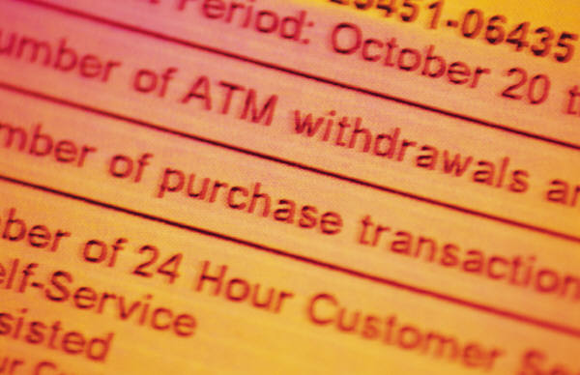

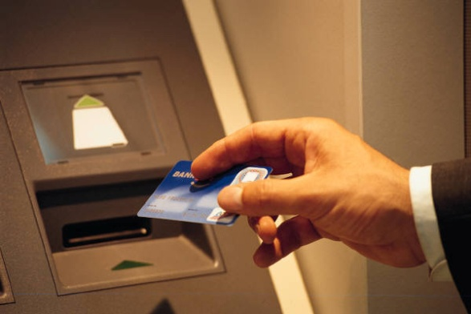
Transactions
A transaction is a logical unit of work carried out by a user or an application
In practice, there are different ways to specify the scope of transactions.
One of them is to use BEGIN END blocks in procedural SQL
Notes:
Before we move to talk about the next requirements, we need to talk about transactions.
A transaction is a set of operations, a group of interactions with the database.
It is a unit from the point of view of the user.
A transaction is for instance the booking of your dream vacation. It involves booking flight tickets, land transfers and hotel rooms.
A transaction is for instance the transfer of money from one of your bank accounts to another. It involves withdrawing the amount from the first account and depositing it to the second account.

Slide 24
ACID Properties
Recovery
Atomicity: all actions in a transaction happen or none happen
Durability: effects of successful transactions last
Concurrency Control
Isolation: Transactions can be understood independently from each other
Consistency: If individual transactions would leave the application in a consistent state, a concurrent execution should do the same
Notes:
With respect to recovery, we want the Database Management System to guarantee the following properties for transactions.
Transactions should be atomic.
Either all the operations in the transaction happen (the transaction is committed and its effects recorded in the database) or none happen (the transaction is aborted and rolled back entirely). Even if the application, the system, or the media crash.
If you transfer money from one account to the other and the system crashes in the middle of the operation, you don’t want the money to be debited from your first account and not be credited to your second.
If you transfer money from one account to the other and go beyond your credit limit on the first account (an integrity constraints that says that you cannot be in the red for more than such an amount), you would like the money to be credited to your second account although it cannot be debited from your first account. The database management system will not let that happen.
Transactions should be durable. Even if the application, the system, or the media crash.
Once you have booked your dream vacations, you don’t want the flight reservation to disappear because the disk of the airline database system crashes.
Durability is a synonym to persistence.

Slide 25
Integrity of Data should be Maintained
How to maintain the integrity of data in spite of possible application, system, or media failures?
Notes:
Integrity of data must be maintained.
The database management system should be able to recover from failures of the application, system, and media.
You don’t want the university to tell you “sorry, you have failed this semester because the disk of our database system crashed and we have lost your As and A+”
How can this be avoided?
By remembering (it is called logging) the operations to the database so that transactions can be undone or redone if necessary.
Rumor suggests that Former White House aide Oliver North was caught by US Congressional investigators during the Irangate not only because they could recover the data he deleted but also because they could see the log of operations showing that he tried and deleted the data!

Slide 26
Consistent States
A consistent state of the database is a state which complies with the business rules as usually defined by integrity constraints
“students who have not passed cs2102 cannot take cs3223”
If the integrity constraints are violated by a transaction, the transaction is aborted and rolled back, otherwise, it is committed.
Notes:
Integrity of the data should also be maintained with respect to business rules of the application. Such rules are managed by the database management system in the form of integrity constraints.
In the university database we can express prerequisite rules for instance.
“students who have not passed cs2102 cannot take cs3223”
We call consistent state of the database, a content of the database, a set of data that complies with the business rules as defined by integrity constraints.
A transaction whose effects violate the integrity constraints is rejected (we say aborted and rolled back as its effects are undone).
The database management system will reject registrations to CS3223 for students who did not pass CS2102.
A transaction that does not violate the integrity constraints is committed. Its effects are recorded in the database.
We study in this module how to express integrity constraints in SQL.

Slide 27
Distributed and Concurrent Access
How can data be shared by users and processes that are possibly distributed over a network?
Notes:
Data is shared and accessed concurrently from distributed locations.
There are millions of users worldwide accessing at the same time the Global Distribution Systems for online hotel and flight reservation and car rental: Amadeus, Galileo, Sabre, and Worldspan.
With the Internet, it is easy to make any application available online and allow distributed access but, consequently, the application should support concurrent access.
The database management system provides support for concurrent and distributed access to the data. The data can be shared among geographically distributed users and processes.

Slide 28
Security and Access Control of Data is Critical
How to protect the data and define and control access to data?
Notes:
Security of data must be maintained and access controlled.
Finally, it is clear that most of the applications that we have mentioned or thought about as typical database applications manage critical enterprise data and require security and access control.
You do not want unauthorized persons staff to view your marks and grades and you only want the lecturer in charge to be able to enter and modify them.

Slide 29
Definitions
DCL: Database Control Language. It include statements to administer access privileges and transactions properties
Notes:
The statements to administer access privileges and transaction properties belong to the database control language or DCL.
We do not have time this semester to study these aspects but you may refer to Ramakrishnan’s textbook for a discussion on security and access control.

Slide 30
In Summary
A database application manages homogeneous collections containing large amounts of persistent structured data that are shared among distributed users and processes and whose integrity must be maintained and security controlled
Notes:
In summary:
“A database application manages homogeneous collections containing large amounts of persistent structured data that are shared among distributed users and processes and whose integrity must be maintained and security controlled”

Slide 31
Conclusion
We have identified the typical requirements of database applications
We have identified Database Management Systems as the platforms for database applications
We have identified the topics to study in this course: design and programming
Notes:
In conclusion,
we have identified the typical requirements of database applications.
Of course not all database applications have all these requirements
we have identified Database Management Systems as the platforms for database applications
So any application can use a database management system if it has one or more of the requirements supported by the DBMS technology.
Finally we have identified the topics that we want to study in this course: design and programming of database applications with relational database management systems.

Slide 32
Syllabus
Design
Entity Relationship Model
Relational Model
Normalisation with Functional Dependencies
Programming
Theory of Query Languages: algebra and calculi
SQL
SQL and Programming Languages
Notes:
In this course we study the essential concepts and techniques underlying design, programming and management of database applications with relational database management systems.
We study conceptual modeling with the Entity Relationship Model
We study logical modeling with the Relational Model and Normalisation with Functional Dependencies
We study the Theory of Query Languages: algebra and calculi
We study the most commonly used practical data definition and manipulation language SQL and how it interacts with programming languages for the development of complete applications

Slide 33

Credits
The content of this lecture is based on chapter 1 of the book “Introduction to database Systems”
By S. Bressan and B. Catania, McGraw Hill publisher
Clipart and media are licensed from Microsoft Office Online Clipart and Media
Copyright © 2016 by Stéphane Bressan

